Slide 1
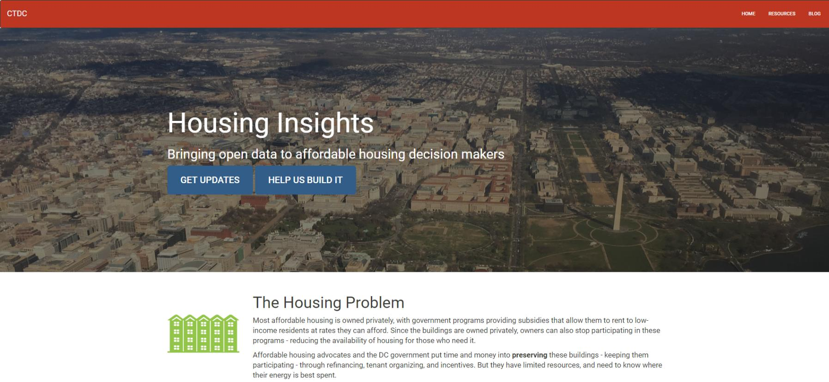
Using open data to inform affordable housing policy
Notes:
PETER: Focus is on affordable housing preservation in Washington, DC.
Had previously decided to do something on affordable housing: priority issue for city as well as CTDC partners.
During planning process, we spoke with key stakeholders, including housing agency heads, Mayor’s office, nonprofit developers and affordable housing advocates.
Consensus emerged that a tool to apply data to support decision making around affordable housing preservation would be most useful course to pursue.
Builds on work that the DC Preservation Network (preservation strategy) and city (Strike Force) have been doing.

Slide 3


The Problem
Affordable Housing
Data
Most is privately owned; government provides incentives
Owners can choose to stop receiving incentives (under certain circumstances)
Advocates and government agencies can often intervene – spending time and money to preserve these buildings
Need to know how to prioritize preservation efforts.
Dozens of overlapping programs (Section 8, tax credit, DC gov, etc.), data isn’t centralized
Neighborhood info is relevant – demographics, transit locations, nearby economic development, other affordable options in the neighborhood.
City-wide analysis can reveal tradeoffs not apparent at building level.

Slide 4
Why tech is part of the solution
Build it once – use often. Time needed to use data is lower.
Add transparency to prioritization process
Proactive housing preservation
Data driven decision making

Slide 5

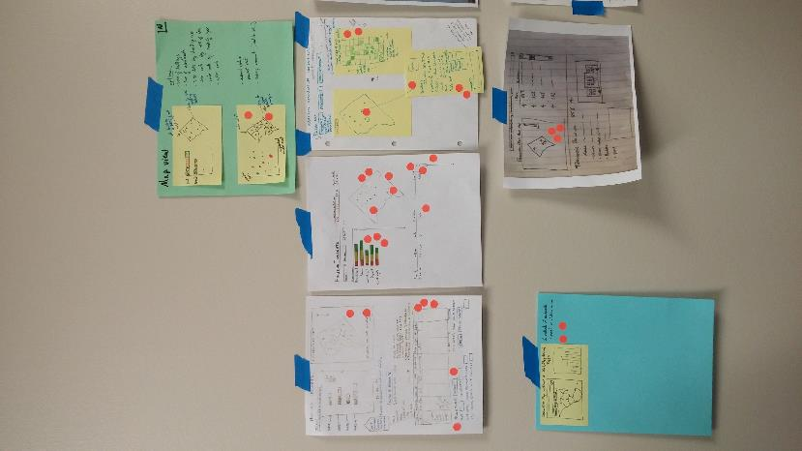
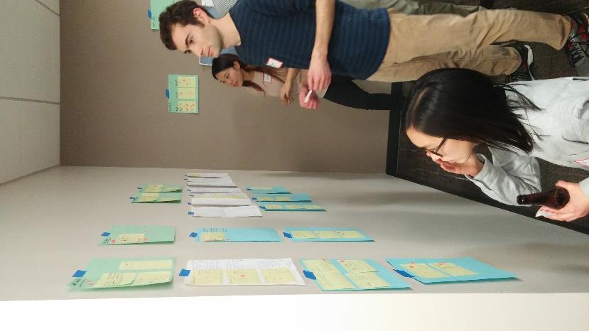
Where are we now?

Slide 6
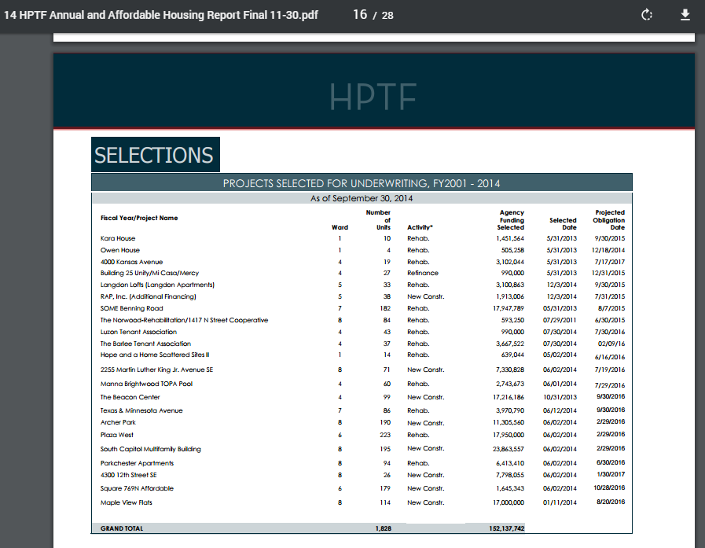
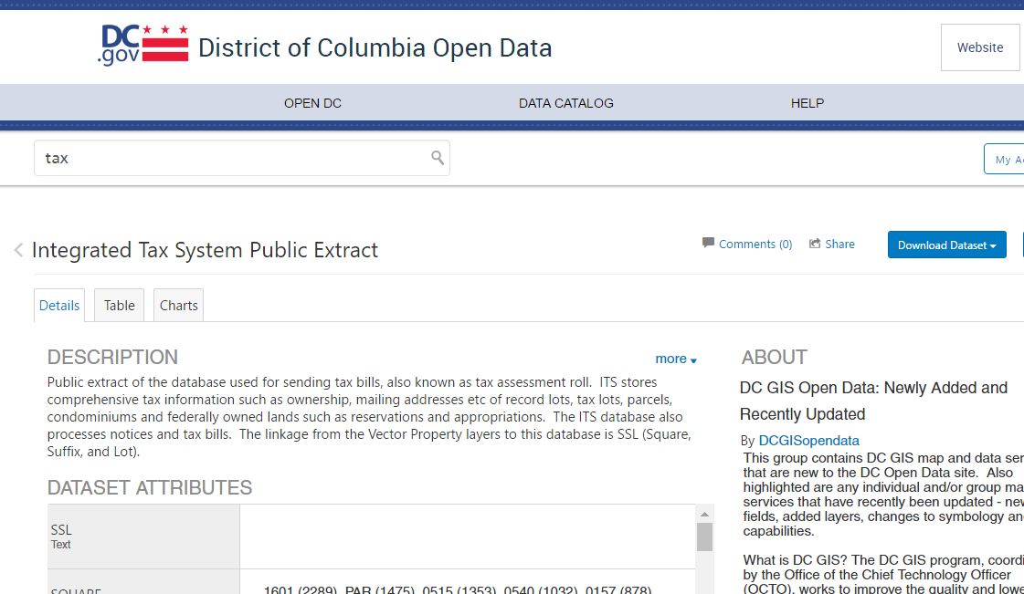
Challenges: Easy vs. Hard Data

Slide 7
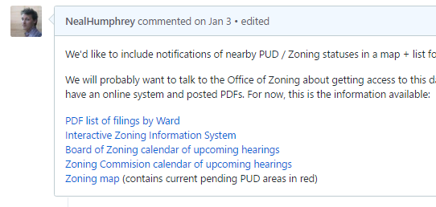
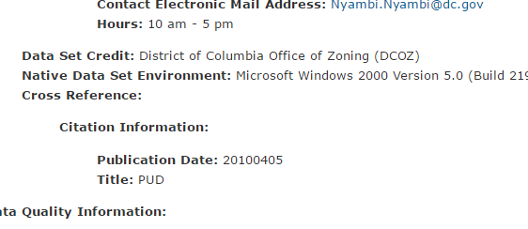
Challenges: Which one is current?
Multiple sources
opendata.dc.gov

Slide 8
Challenges: Political change is built in
“We want the District to use data and a consistent approach to ranking priorities in allocating funding for affordable housing preservation.”

Slide 9
Join us!
housinginsights.org
Monthly partners newsletter
Weekly coding sessions

